Slide 1
Automated PetCare System
Daniel Ritter and Matthew Burket

Slide 2
Background Information
Over 65% of U.S. Households have pets
Of those households, there are 85 million pet cats and 75 millions pet dogs
Estimated 70% of households vacation at least once a year.
Vacation durations ranging from 5 to 14 days

Slide 3
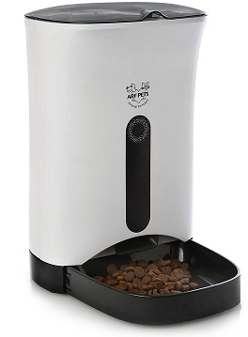
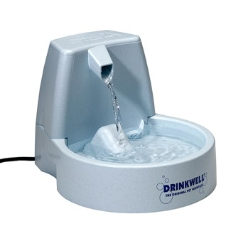
Problem Statement
Kennels are an expensive recurring cost
Current automated care methods are expensive, lack reliability/control, and only have a singular function

Slide 4
Solution
Connect and control various apparatuses needed to care for your Cat or Dog
Food, Water, Laser toy
Automate feeding and watering of your pet
Allow owner to control, interact with, and remotely check on the status of the system while away from home

Slide 5
Project Features
Automated feeding from user-defined daily schedule
Automated watering
System calculates and updates the estimated percent remaining in the food and water reservoirs
User defines parameters: text warnings and reservoir warning levels
System hosts a website that streams a live video feed from the Webcam, allows user to pan/tilt the webcam, and turn on or off the laser toy
System also informs user of food/water reservoir percent remaining statuses via the webpage

Slide 6
Alternate Designs
Website Layout and functionality
Waterflow Rate Analysis

Slide 7
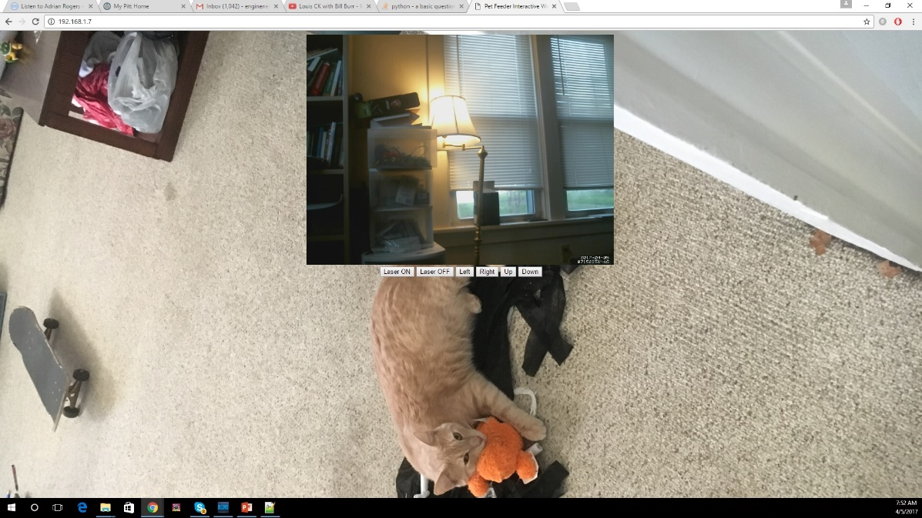
Original Website
Boring
Lacked Feedback
Not Mobile Friendly

Slide 8
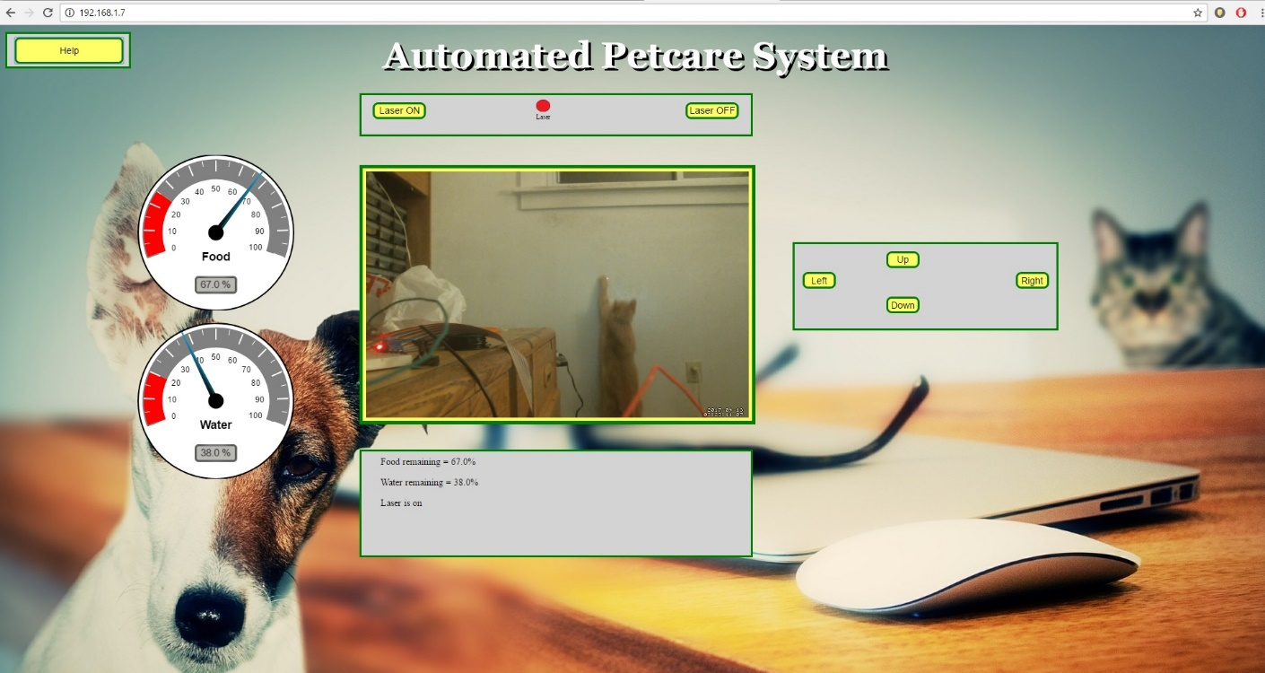
Website Final Version
Button orientation
Food/Water Reservoir Status Feedback
Updated Background/ Visual Enhancements

Slide 9
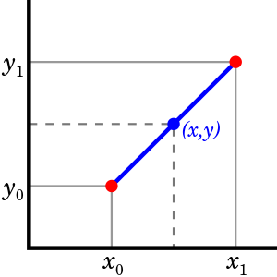
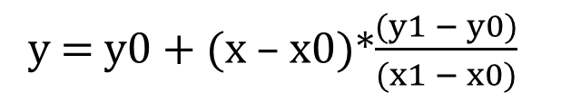
Waterflow Rate Analysis: Original Version
Used to Estimate a Value Between 2 Known Points
Complicated
Inaccurate
y = y0 + (x – x0)*$\frac{(y1 − y0)}{(x1 − x0)}$

Slide 10
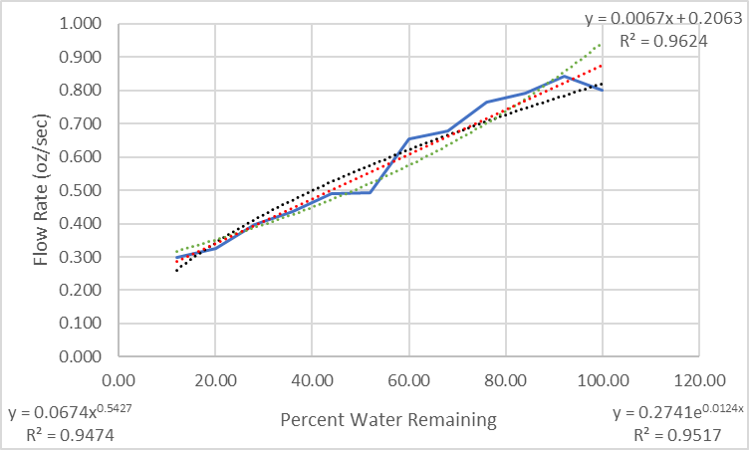
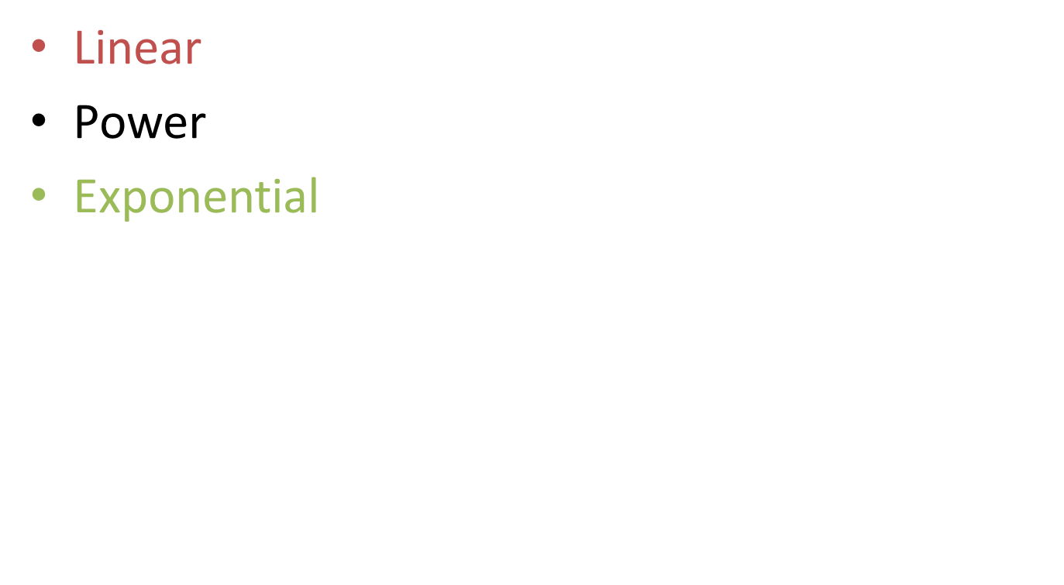
Waterflow Rate Analysis: Final Version
Linear
Linear
Power
Exponential
${y=0.0674x}^{0.5427}$
Power
Exponential

Slide 11
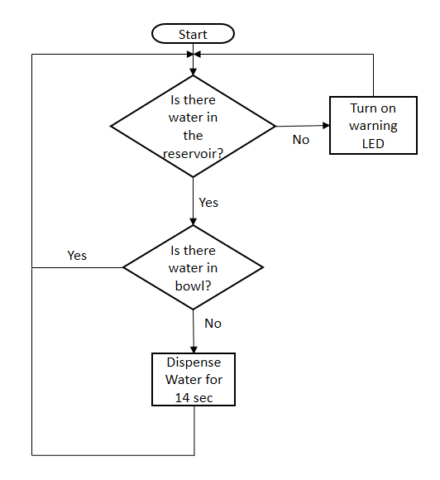
Watering Flowchart

Slide 12
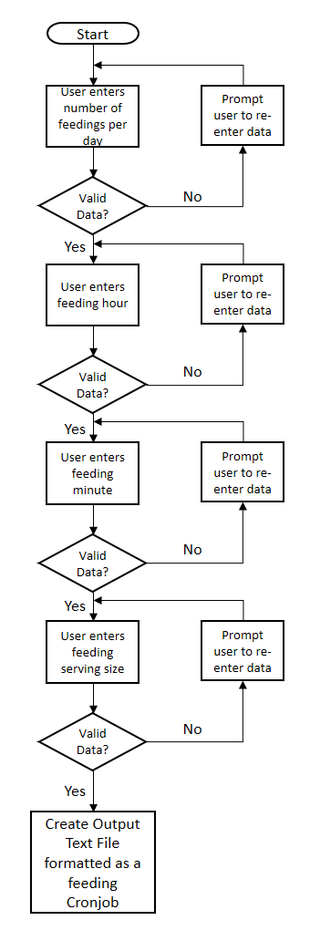
Feeding Flowchart

Slide 13
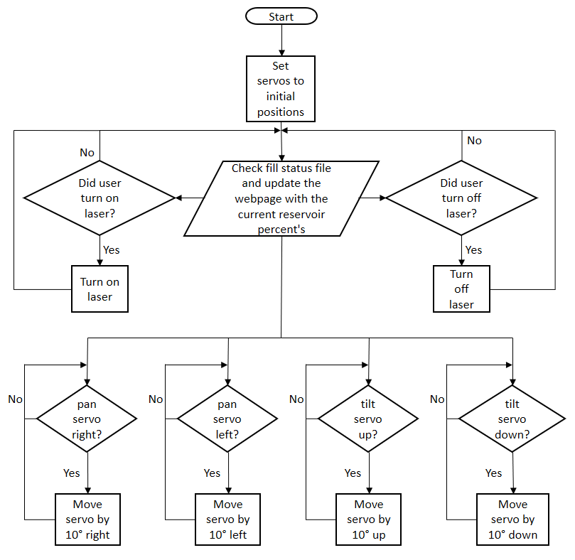
Webpage Flowchart

Slide 14
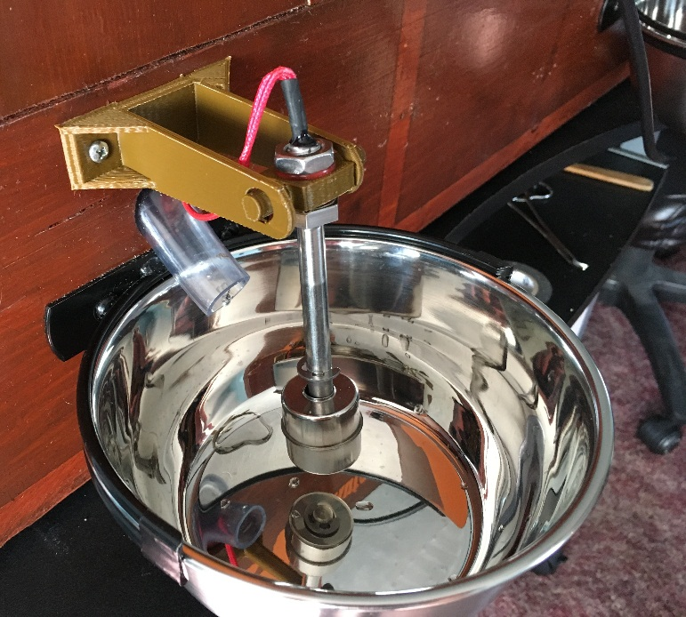
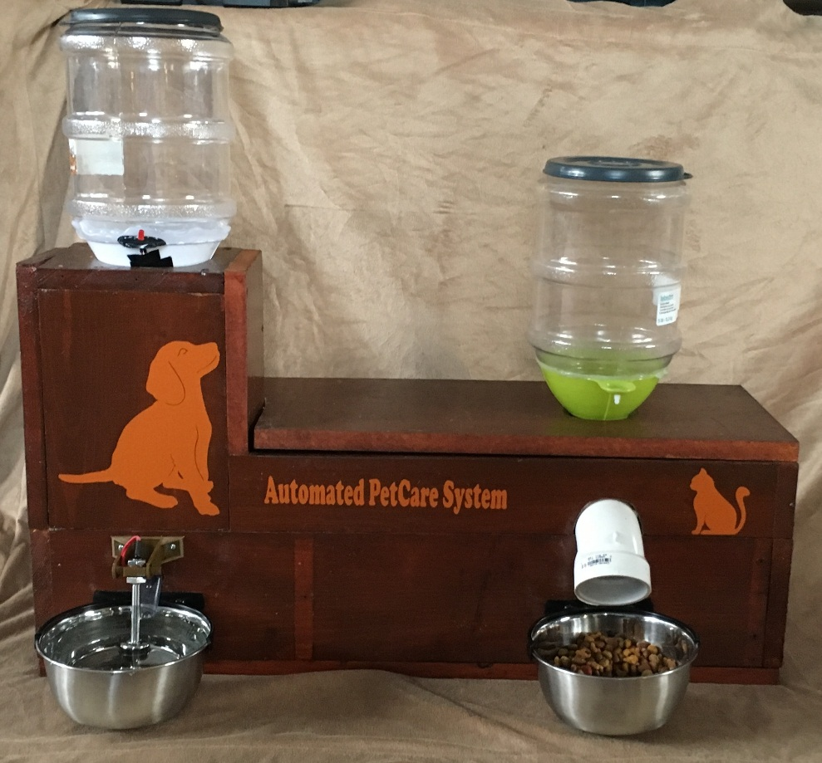
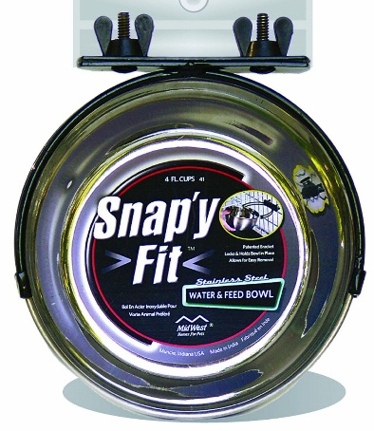
Final Design (The Enclosure and 3D Printed Parts)
Water Bowl Sensor Mount
Snap’y Fit Food/Water Bowls

Slide 15
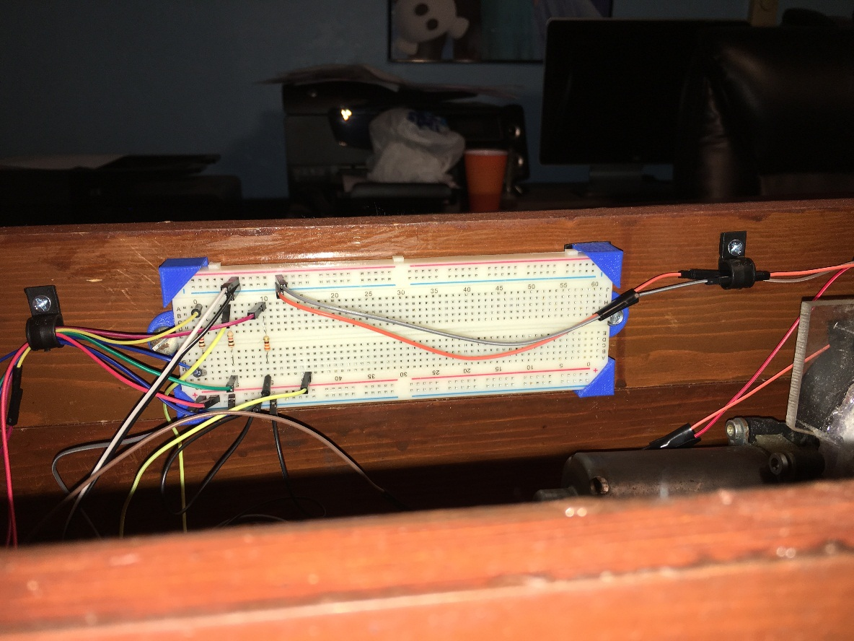
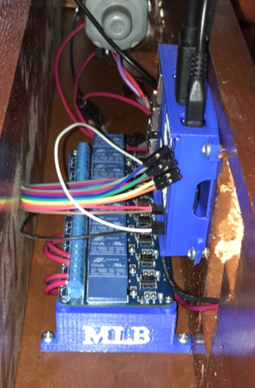
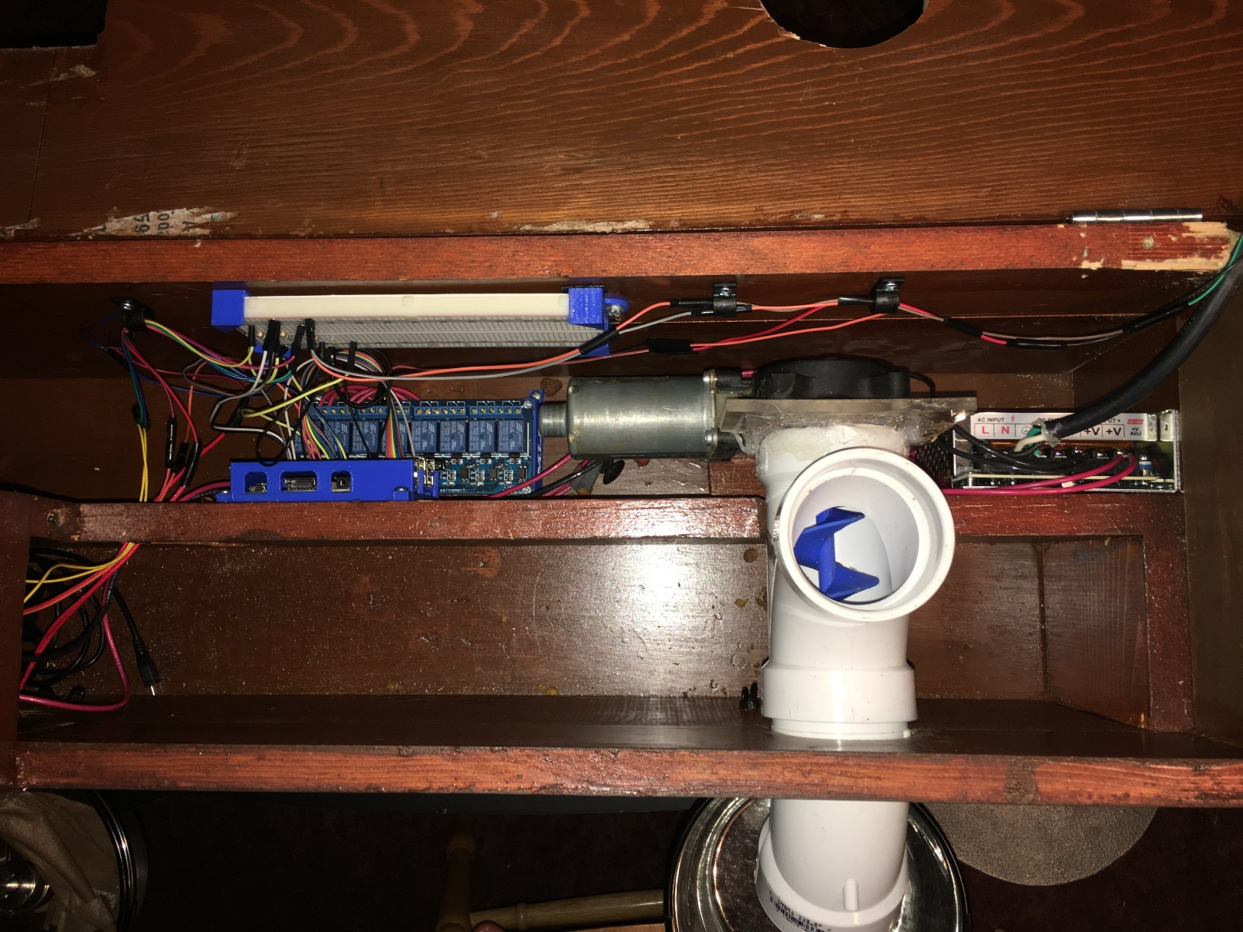
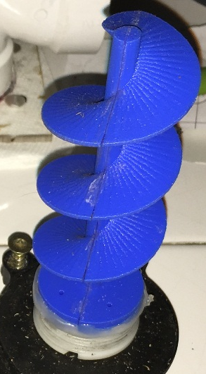
Final Design (The Enclosure and 3D Printed Parts)
Raspberry Pi Case
Relay Module Mounts
Breadboard Mounts
The Auger

Slide 16
Block Diagram
Power Wires
Data Wires
120 Volt AC
Laser Toy
120 VAC to 12 VDC Power Supply
Raspberry Pi Power Supply
Arduino
Power Supply
Motor to Dispense Food
Solenoid Valve to Dispense Water
Camera Module
8-Channel Relay
Sensor to Detect Water in Bowl
Raspberry Pi 3 Model B
Arduino
Sensor to Detect Water in Reservoir

Slide 17
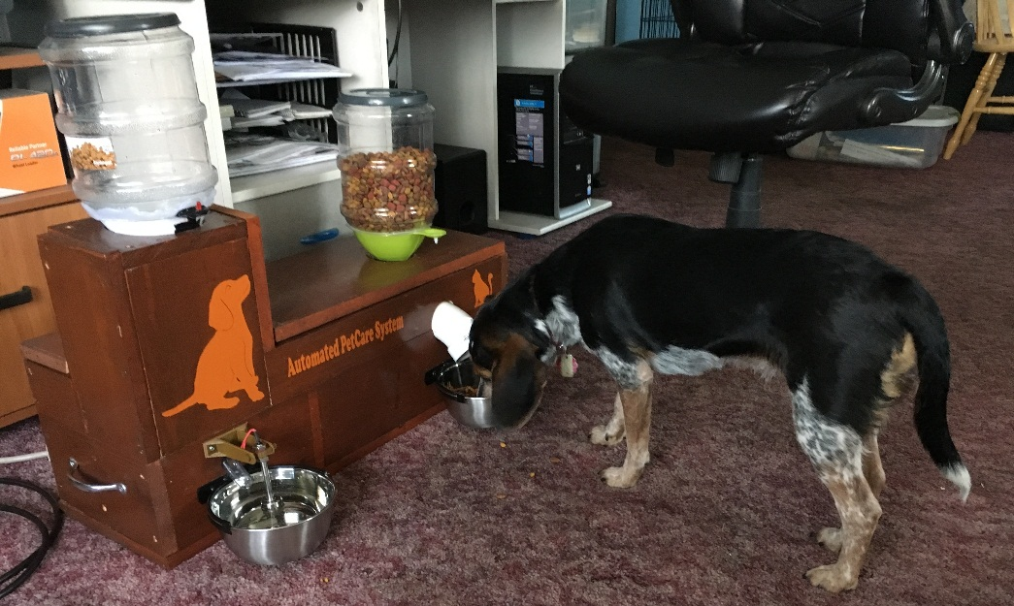
Testing
a

Slide 18
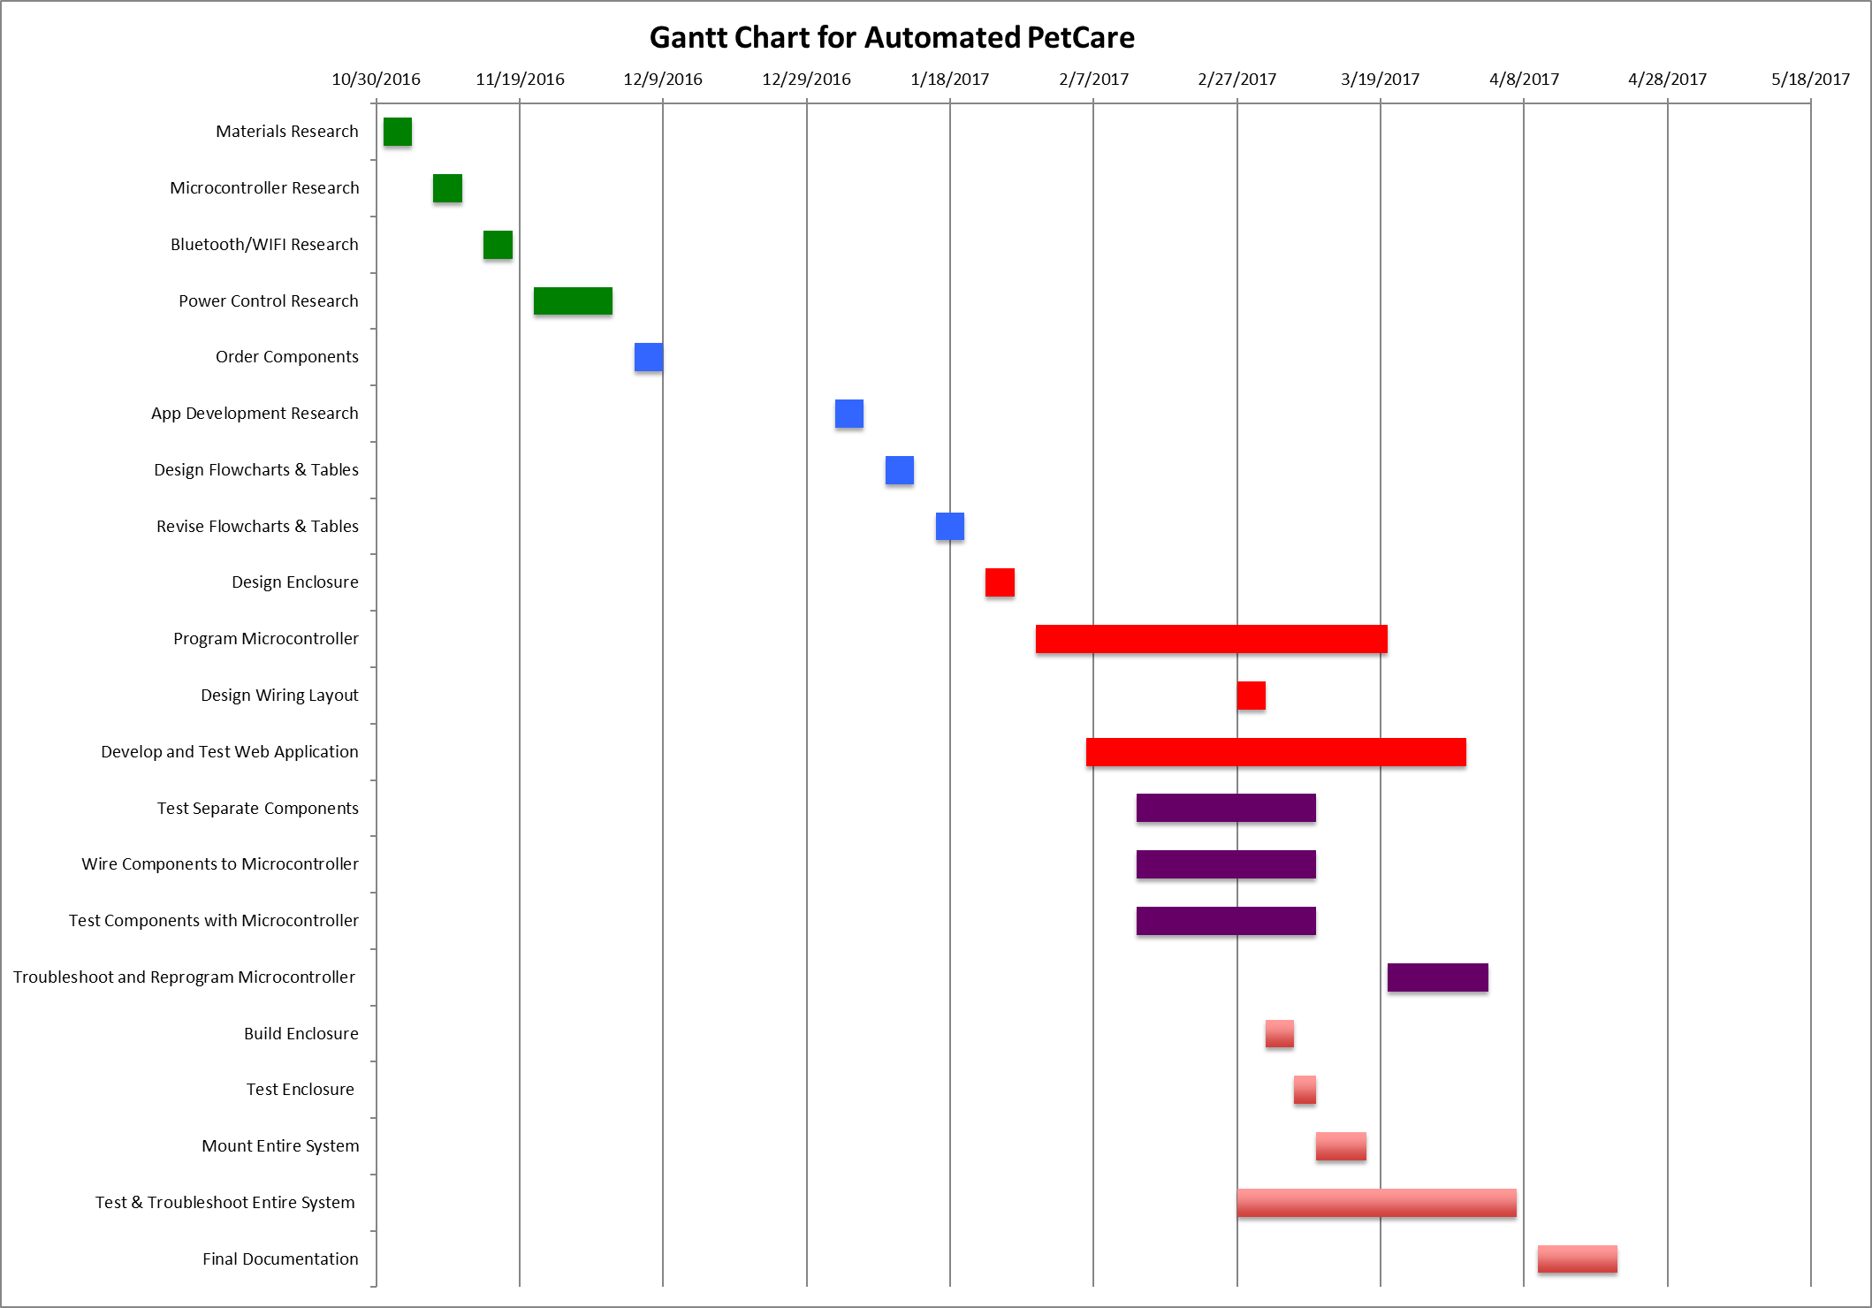
Gantt Chart

Slide 19
Task Hours
Labor (Hours on Tasks)
Tasks | Hours
 | Matt | Dan |  | Both
Materials Research | 3 | 3 |  | 6
Microcontroller Research | 1.5 | 10 |  | 11.5
Bluetooth/WIFI Research | 2.5 | 1 |  | 3.5
Power Control Research | 2.5 | 5 |  | 7.5
Food/Water Dispense Rate Research |  | 10 |  | 10
Order Components | 6 | 6 |  | 12
App Development Research | 1 | 20 |  | 21
Design Flowcharts & Tables | 2 | 1 |  | 3
Revise Flowcharts & Tables | 5 | 1 |  | 6
Design Enclosure | 3 | 2 |  | 5
Program Microcontroller | 20 | 100 |  | 120
Design Wiring Layout | 2 | 6 |  | 8
Develop and Test Web Application |  | 15 |  | 15
Wire Components to Microcontroller | 3 | 2 |  | 5
Test Components with Microcontroller | 6 | 15 |  | 21
Troubleshoot and Reprogram Microcontroller | 10 | 33 |  | 43
Build Enclosure | 12 |  |  | 12
Test Enclosure | 4 |  |  | 4
Mount Entire System | 5 | 3 |  | 8
Test & Troubleshoot Entire System | 8 | 8 |  | 16
Final Documentation | 10 | 4 |  | 14
Total | 106.5 | 245 |  | 351.5
Total Hours on Tasks: 351.5 Hours

Slide 20
Cost of Materials
Automated PetCare System Cost
Item | Quantity | Cost Per Item | Cost | Use | Location Purchased | Notes
PVC Tee | 1 | $ 1.86 | $ 1.86 | Food System | The Home Depot
PVC 45 Deg Pipe | 1 | $ 1.44 | $ 1.44 | Food System | The Home Depot
2 Pc White Funnel | 1 | $ 0.97 | $ 0.97 | Water System | Walmart
Canning Funnel | 1 | $ 1.99 | $ 1.99 | Food System | Tractor Supply Company
Snapy Fit SS Bowl | 2 | $ 9.99 | $ 19.98 | Food and Water | Tractor Supply Company
Yellow Outlet End | 1 | $ 2.79 | $ 2.79 | Power | Fluder Home & Builder Supply | 3 prong plug
Extension Cord Wire | 1 | $ 3.69 | $ 3.69 | Power | Fluder Home & Builder Supply | Power Cord
5lb Feeding Reservoir | 2 | $ 16.99 | $ 33.98 | Food and Water | Tractor Supply Company
5/8 in PVC Tubing | 1 | $ 3.43 | $ 3.43 | Water System | Lowe's | 7 foot - .49 a foot
2 pack Hinge | 1 | $ 3.99 | $ 3.99 | Enclosure | Fluder Home & Builder Supply
Handles | 2 | $ 2.99 | $ 5.98 | Enclosure | Fluder Home & Builder Supply
Water Solenoid Valve | 1 | $ 8.29 | $ 8.29 | Water System | Amazon
Power Supply | 1 | $ 14.98 | $ 14.98 | Power | Amazon | 120VAC to 12VDC
2 pc Water Lever Sensor Right Anlge | 1 | $ 6.55 | $ 6.55 | Water System | Amazon | Sensor for Water Reservoir
2 pc SS Water Level Sensor | 1 | $ 7.66 | $ 7.66 | Water System | Amazon | Sensor for Water Bowl
SainSmart 8-Channel Relay Module | 1 | $ 10.49 | $ 10.49 | Relay | Amazon
Raspberry Pi 3 Model B | 2 | $ 39.99 | $ 79.98 | Microcontroller | Walmart | 1 For Each Person in Group
Auger | 1 | $ 3.00 | $ 3.00 | Food System | Donated - Cost Estimated | 3D Printed
Raspberry Pi Case/Mount | 1 | $ 3.00 | $ 3.00 | Enclosure | Donated - Cost Estimated | 3D Printed
Relay Module Mounting Stand | 1 | $ 1.00 | $ 1.00 | Enclosure | Donated - Cost Estimated | 3D Printed
Breadboard Mount | 1 | $ 0.50 | $ 0.50 | Enclosure | Donated - Cost Estimated | 3D Printed
Water Bowl Sensor Mount | 1 | $ 1.50 | $ 1.50 | Enclosure | Donated - Cost Estimated | 3D Printed
Pan/Tilt Servo Module | 2 | $ 19.99 | $ 39.98 | Web Controls | Amazon | 1st module was defective
Lasers | 10 | $ 1.00 | $ 10.00 | Web Controls | Ebay | Came in a 10 Pack
WebCamera | 1 | $ 49.99 | $ 49.99 | Video Feed | WalMart
USB Powered HUB | 1 | $ 19.99 | $ 19.99 | Microcontroller | Amazon | Needed to Ease the Power Load on Our Microcontroller
Motor | 1 | $ 30.00 | $ 30.00 | Food System | Donated - Cost Estimated Ebay | Rear Window Volvo Motor
Enclosure Wood | 3 | $ 14.48 | $ 43.44 | Enclosure | Donated - Cost Estimated Lowe's | (Common: 1-in x 12-in x 8-ft; Actual: 0.75-in x 11.25-in x 8-ft) Pine Board - Lowe's: $14.48 each
Miscellaneous Items | 1 | $ 30.00 | $ 30.00 | Other |  | Resistors, Wires, Screws, Clamps, LEDs, etc.
Total Cost |  |  | $ 440.45
Total Cost of Materials: $440.45

Slide 21
Cost of Project
Senior Project Cost Analysis
 |  |  | Equations
Labor Hourly Cost | $ 30.00 | /hour | ($60,000/year)*(1 year/50 weeks)*(1 week/40 hours)
Overhead Cost | $ 45.00 | /hour | Labor Hourly Cost*1.50
Total of Salary and Overhead | $ 75.00 | /hour | Labor Hourly Cost + Overhead Cost
20% Profit Margin for the Company Applied to Labor and Overhead Costs | $ 93.75 | /hour | (Total of Salary and Overhead) / (1-0.2)
Total Cost of Labor, Overhead and Anticipated Profit | $ 32,953.13 |  | Time on Tasks*20% Profit Margin for the Company Applied to Labor and Overhead Costs
Cost of Materials | $ 440.45
Total Project Cost for Amortized Engineering Costs | $ 33,393.58
Total | $ 33,393.58
Total Cost of Project: $33,393.58

Slide 22
Conclusion

Slide 23
Thank You!
Parents
Chad Walters
Clarance “Hooker” Anderson
Chris McCorkel
Professor Chandana Jayasooriya

Slide 24
Automated PetCare System
Questions?

